Slide 1
Site and Some Tools Available in 10 Languages

Slide 2
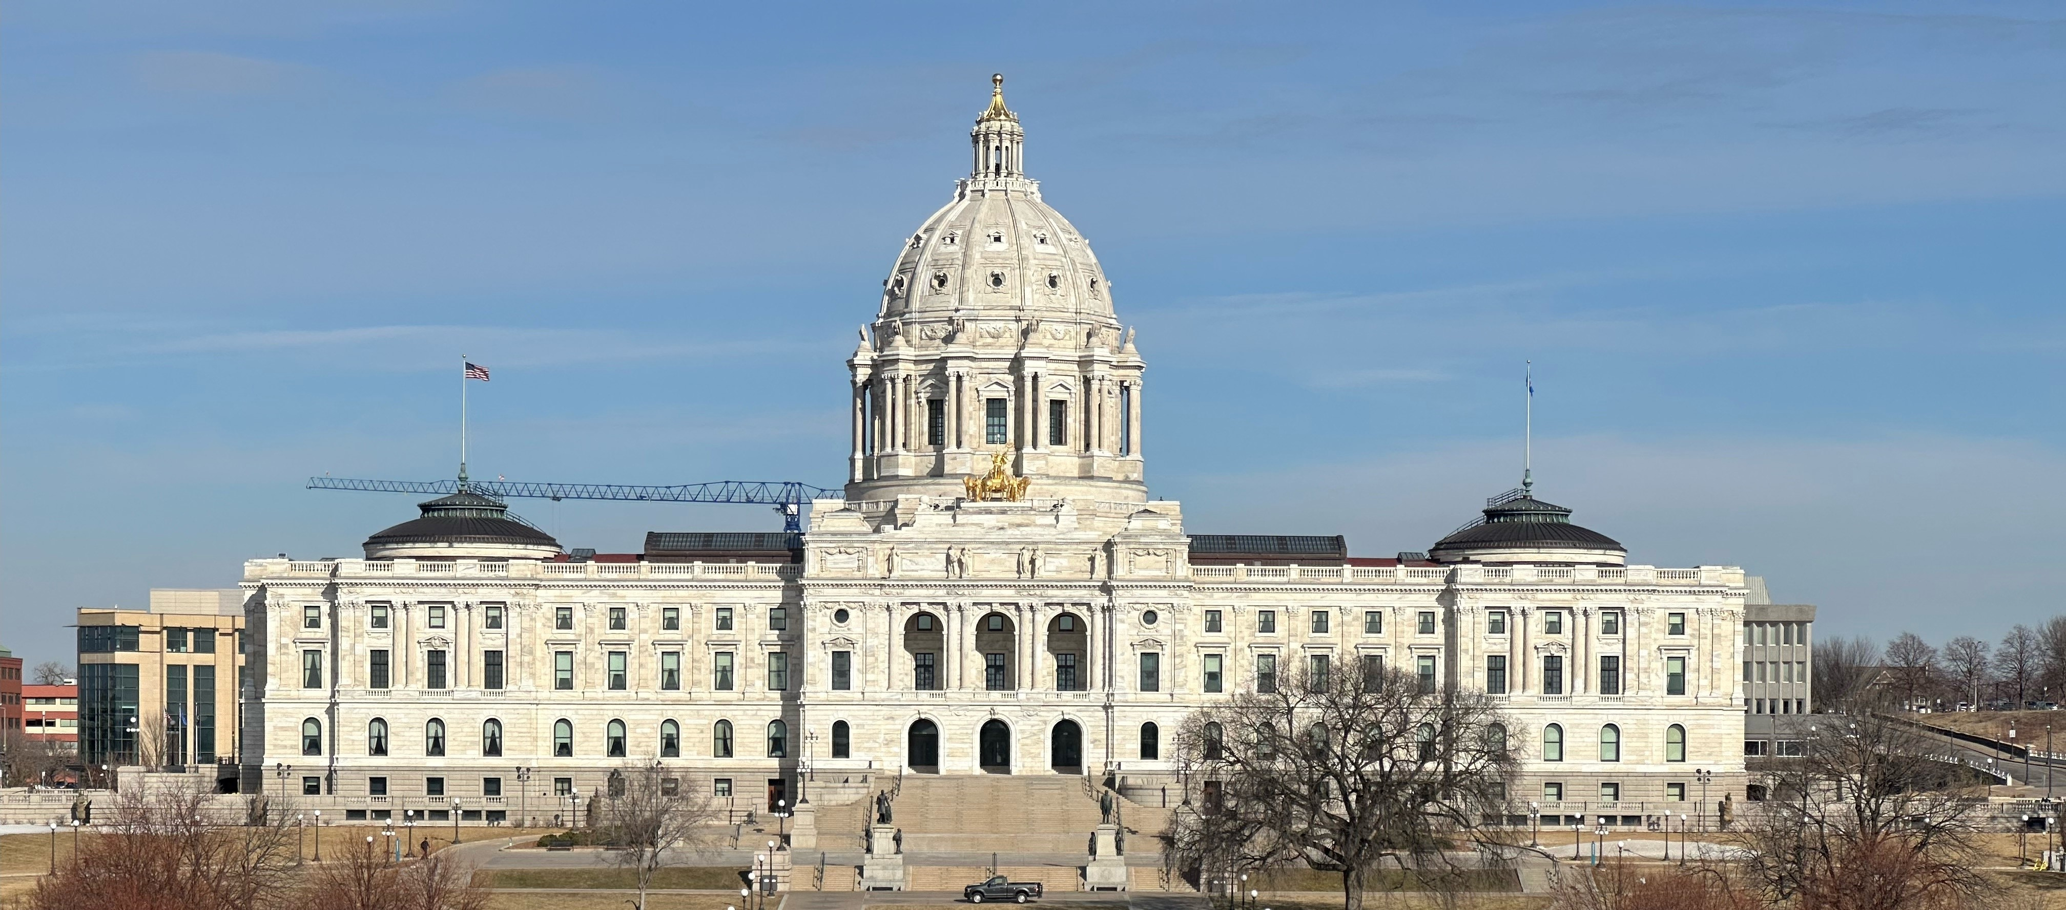
Teaching and Preaching Minnesota Caucuses
-------------

Slide 3
AGENDA
Welcome
What, Who, When, Where, How
DFL Caucuses
GOP Caucuses
Q+A/Discussion

Slide 4
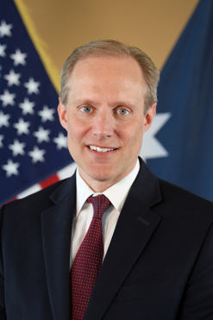
Welcome!

Slide 5
Caucuses: WHAT, who, when, where, how
Part of the process; Outside of the process
By definition:
  Meetings run by/for parties, not the government
  Precinct Caucuses→ State Party Conventions
  Endorse Candidates
  Select delegates
  Propose ‘planks’ for party ‘platform’ (goals, values)
  General similarities & specific differences

Slide 6
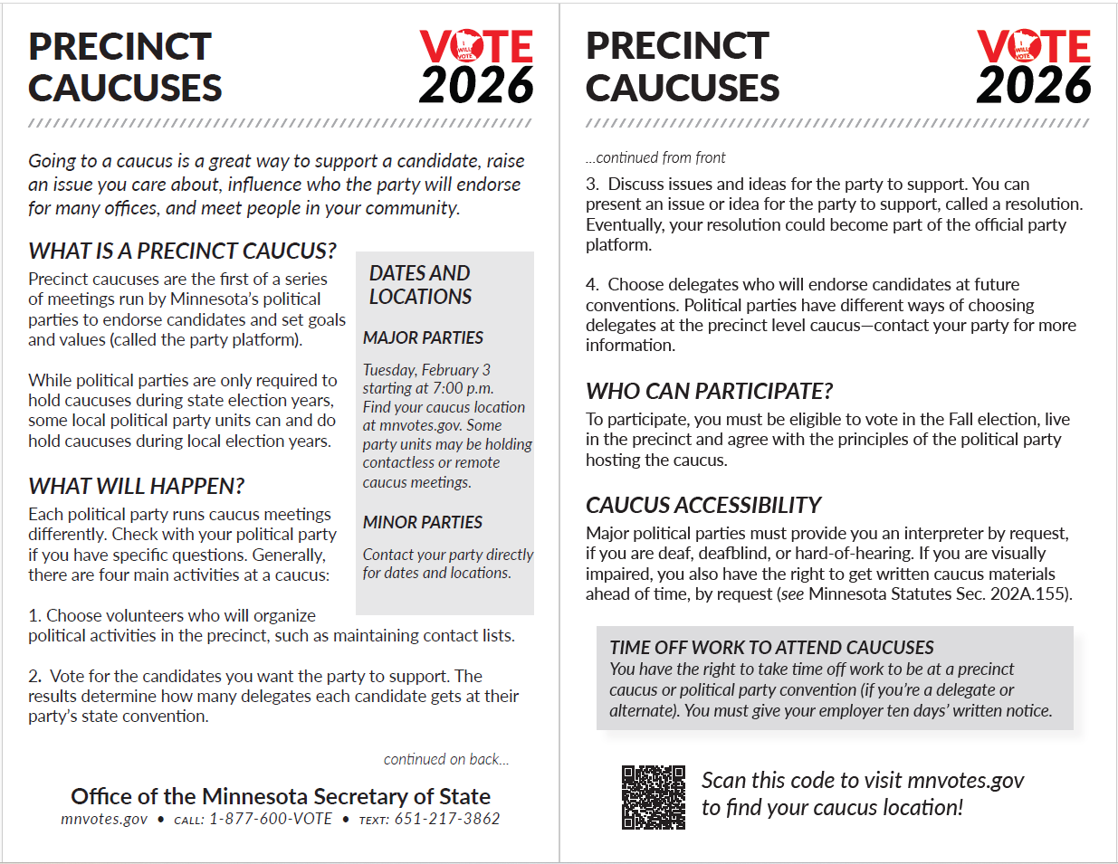

Slide 7
Caucus: WHAT, who, when, where, how
General Information at
https://www.sos.mn.gov/elections-voting/how-elections-work/precinct-caucuses/
Series of meetings
  Precinct Caucus (generally neighborhood-based)
  BPOU/OU (Basic Political Organizing Unit/Organizing Unit) Convention
    Senate or house district, or county
  Congressional District Convention
  State Convention
  National Convention

Slide 8
What gets done
at each meeting?
https://dfl.org/caucuses-conventions/process/
https://mngop.com/caucus-2026/
https://www.carvergop.org/caucus-to-party.html

Slide 9
What gets done?
At Precinct Caucus:
MEET/TALK WITH
YOUR NEIGHBORS

Slide 10

Precinct Caucus – elect Unit delegates and local leadership; adopt resolutions that are considered at conventions
Basic Political Organizing Unit Convention – usually a senate or house district or county; endorse candidates for local elected office; elect unit officers; elect state/congressional delegates
/
Congressional District Convention – endorse U.S. House candidate; elect district officers; elect national delegates
State Convention – endorse candidates for statewide offices and U.S. Senate; elect party officers; adopt state party platform
National Convention – endorse presidential nominee; elect national party officers; adopt national party platform

Slide 11
Precinct Caucus – elect Unit delegates and local leadership; adopt resolutions that are considered at conventions
Basic Political Organizing Unit Convention – usually a senate or house district or county; endorse candidates for local elected office; elect unit officers; elect state/congressional delegates
Congressional District Convention – endorse U.S. House candidate; elect district officers; elect national delegates
State Convention – endorse candidates for statewide offices and U.S. Senate; elect party officers; adopt state party platform
National Convention – endorse presidential nominee; elect national party officers; adopt national party platform

Slide 12
Who can participate?
Eligible to vote in the general (November) election
Live in the precinct
18 by Election Day? You are welcome to participate!
REMINDER: Minnesota does NOT have party registration
Do I believe in the general principles of the party? (Like the PNP)
Guest/Observer? ASK YOUR PARTY

Slide 13
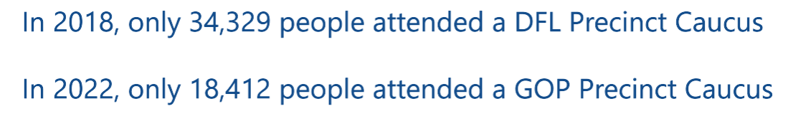
Who can participate?
In 2016, the law changed and a Presidential Nomination Primary replaced that vote from the caucuses
In 2018, Minnesota had 5.61 million inhabitants
In 2022, Minnesota had 5.72 million inhabitants

Slide 14
Caucus: WHEN, WHERE, how
Tuesday, February 3, 2026, 7 p.m. start
  MN 202A.14 PRECINCT CAUCUS
  Your caucus location is set by the party
    MN OSS Caucus Finder Tool: https://caucusfinder.sos.mn.gov/
    Or contact your party
    CANNOT ATTEND? Non-Attendee Form

Slide 15
Caucus: WHEN, where, how
MN 202A.19 permits Minnesota residents to take time off from work without pay to attend precinct caucuses
Give employer 10+ day written notice
State universities, community colleges, and public schools
No classes or events after 6 p.m. on precinct caucus day.
Same with state agencies, school boards, county boards, township boards, city councils, and all other political subdivisions.

Slide 16
Caucus: HOW
Everyone has a voice
  Choose local volunteers who organize the precinct
  Put your name in to be a delegate (vote at the next level)
  Resolutions (an issue or idea for the party to support)
    Propose
    Support or speak against resolutions
    Speak for or against a candidate
  Volunteer to help
  SPEAK UP FOR WHAT YOU BELIEVE

Slide 17
Caucus: WHO is responsible?
The parties.
Democratic-Farmer-Labor Party
(651) 293-1200
Republican Party of Minnesota
(651) 222-0022
Forward Independence
(651) 998-9156
Grassroots-Legalize Cannabis Party
Libertarian Party of Minnesota
(612) 440-1776
Minnesota Legal Marijuana Now! Party
(612) 866-8424

Slide 18
MN Republican Party
Patricia Williamson
Chair, Carver County Republicans

Slide 19

What happens at Caucus?
WHAT IS A PRECINCT CAUCUS?
  Precinct caucuses are meetings run by Minnesota’s political parties. They are the first in a series of meetings where parties may endorse candidates, select delegates, and set goals and values (called party platforms).
WHO CAN PARTICIPATE IN A CAUCUS?
  To participate, you must be eligible to vote in the next general election and live in the precinct. You also must generally agree with the principles of the political party hosting the caucus.
Generally, there are three main activities at a caucus:
Choose volunteers who will organize political activities in the precinct (Precinct Officers). This could include maintaining contact lists, holding political meetings, and helping with campaign efforts.
Discuss issues and ideas for the party to support. You can present an issue or idea for the party to support, called a resolution.
Choose delegates who will endorse candidates at future conventions. These delegates serve for a 2 year period and are part of the party, they have the ability to elect party leadership during odd year conventions. Delegates are a critical component of an informed electorate.
https://www.sos.state.mn.us/elections-voting/how-elections-work/precinct-caucuses/

Slide 20
What does a Delegate do?
There are lots of things a Precinct Delegate can do. YOU MAKE THE MOST OF IT.
  Continue as a voting delegate to Conventions at the local, Congressional District, State, and National level (Representation).
  Become a precinct officer and serve on the local Party Committee, (Decision making and governance).
  Be an informed person in the community to help motivate and guide voters (Outreach).
  Gain information by attending Party Meetings (Education).
  Attend events and support Party efforts (Engagement).
  Connect with other conservatives (Network)

Slide 21


There’s so much you can do!
Be part of TEAM GOP
  Attend Caucus
  Go to Conventions
  Ask questions at Town Halls
  Be in parades
  Serve on a sub-committee
  Volunteer at the County Fair
  Attend Events
  Be an Election Judge
  Support a Candidate
  Be a Local Candidate
  Attend Fundraising events
  Networking
  Support outreach- door knocking efforts
  Host a Candidate Meet and Greet
  Participate in local government
  Be an active and engaged citizen!
Citizen involved governance
Delegates
Alternates
All Citizens

Slide 22
DFL Party of Minnesota
Sonja Johnson
Training and Party Affairs Director

Slide 23
Teaching and Preaching Caucuses
January 2026

Slide 24
The Purpose of the DFL
MN DFL Constitution, Article I, Section 4.
Purpose. The purpose of the DFL Party is to elect candidates to public office who represent the party’s shared values. Those shared values are embodied by the DFL Party Platform, consisting of the Ongoing Platform and Action Agenda, and by the Charter and Bylaws of the Democratic Party of the United States.
Notes:
Note: Use the second box as a prompt to dig into the details of that line / how it is important to their job.

Slide 25
On Caucus night we start the process of fulfilling our Purpose as an Organization!

Slide 26
Minnesota DFL Party Structure
State
Party
Congressional Districts
Organizing Units
(Might be a County, Senate District, House District or a combination)
Voting Precincts
Notes:
The foundation of the DFL are our voting precincts. The level organizes at precinct caucuses and decides who will represent them at their or
There are 121 Organizing Units (comprised of voting precincts) The Organizing Unit is the basis of local party organization beyond the Precinct Caucus. The boundaries of Organizing Units may be based on county, senate district or house district boundaries but you can only live in one organizing unit.
Organizing Units divided among eight congressional districts in the state of Minnesota. At each level (local, congressional district and state), the DFL party is governed by a Chair, Vice Chair, Treasurer, Secretary, Outreach Officer, Directors and its Executive and Central Committees. Organizing Units also elect State Central Committee Members and Alternate.

Slide 27
Caucus Night Activities:

Slide 28
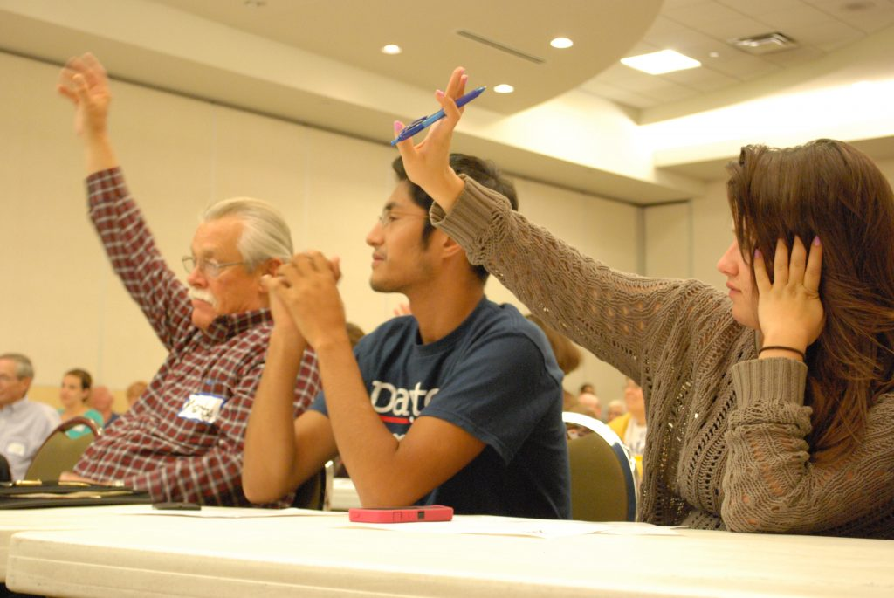
Caucus Night Activities
We elect Delegates and Party Officers!
AKA - Volunteers are elected to represent their communities in the Party
Elect people to positions in the party!

Slide 29
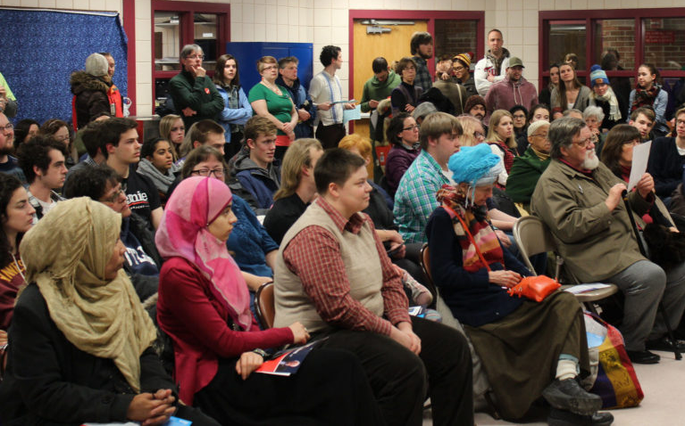
Caucus Night Activities
We pass resolutions to be considered for addition in the DFL Platform
We start the Process of Making Our Platform

Slide 30
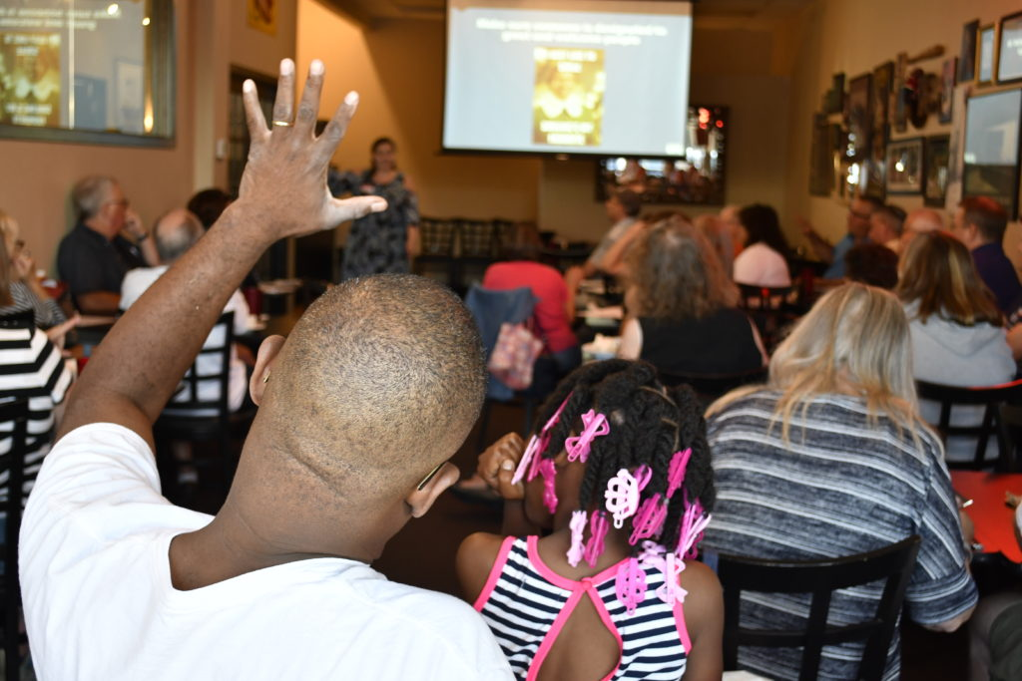
Caucus Night Activities
Ultimately - Caucuses are community meetings of people who have a shared set of values
We listen to our Communities

Slide 31
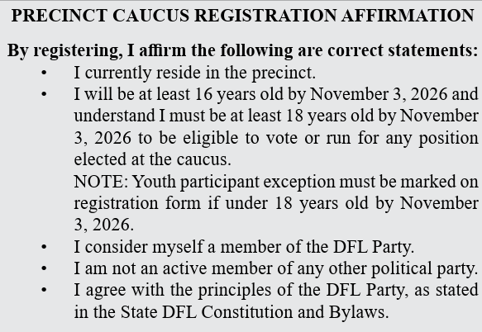
When you register you will agree to:
Who can participate in a DFL Precinct Caucus?

Slide 32
Some of the DFL Young Dems in 2024

Slide 33
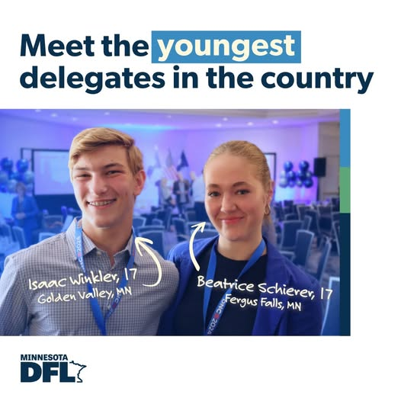

Slide 34
Questions
DFL.org/Caucus
Partyaffairs@dfl.org
Notes:
Note: Use the second box as a prompt to dig into the details of that line / how it is important to their job.

Slide 35
QUESTIONS?

Slide 36
Save the Date
Lunch & Learn Webinar
April 17, noon- 1 p.m.
Everything You (and Young People) Need to Know About Being a Student Election Judge

Slide 37
Michael Wall
Michael.Wall@state.mn.us
651-201-6892

